Slide 1
The Unbalanced Growth Hypothesis and the Role of the State: The Case of China’s State-Owned Enterprises By Carsten A. Holz

Slide 2
Development Background
Rosenstein-Rodan – Big Push
Lewis – Unlimited supply of labor
Rostow – Stages of economic growth
Nurske, Hirschman – Balanced/unbalanced growth
Yotopoulos and Nugent – Quantitative analysis of linkage and unbalanced growth

Slide 3
Hirschman Revisited
“Big Push” to overcome low-level equilibrium trap
Assumes government cannot simultaneously finance all sectors
Avoid social overhead capital (SOC) and focus on directly productive activities (DPA)
Investment in key industries creates supply bottlenecks and profit opportunities for private sector
Linkage importance – net creation of new industries
Linkage strength – probability that creation will occur
Forward and backward linkage

Slide 4
Case of China
Pre-reform (1949-1978) economy
Socialist transformation under Mao Zedong
Planned balanced-growth to achieve “balanced and continuously rapid economic development of social production” and “rational use of resources… inherent to capitalism.”
No consideration of linkage/input-output analysis or Hirschman’s unbalanced growth

Slide 5
China: Post-1979 Reform Period
Deng Xiaoping and economic reforms
Focus on how to allocate limited state resources
Which sectors to invest in, and which to withdraw from?
Following Hirschman’s unbalanced growth
Prioritize sectors with high linkage effects
Withdraw from sectors with low linkage to profits

Slide 6
China as a Subject of Analysis
Ideal with 8 regions and 31 provinces
BUT incomplete public data
National, regional, and provincial data not available or censored
Analytical options are:
National table with linkage coefficients applied equally across all provinces
Regional table with linkage coefficients across all provinces
Allows for variations across regions
Best data: 1997 semi-independent national input output table

Slide 7
State-Owned Enterprises
Key mechanism by which government engages economy
Heavy use prior to reform in 1978
After reform, decline through restructuring, privatization, and growth of non-SOEs
Varied by sector and province

Slide 8
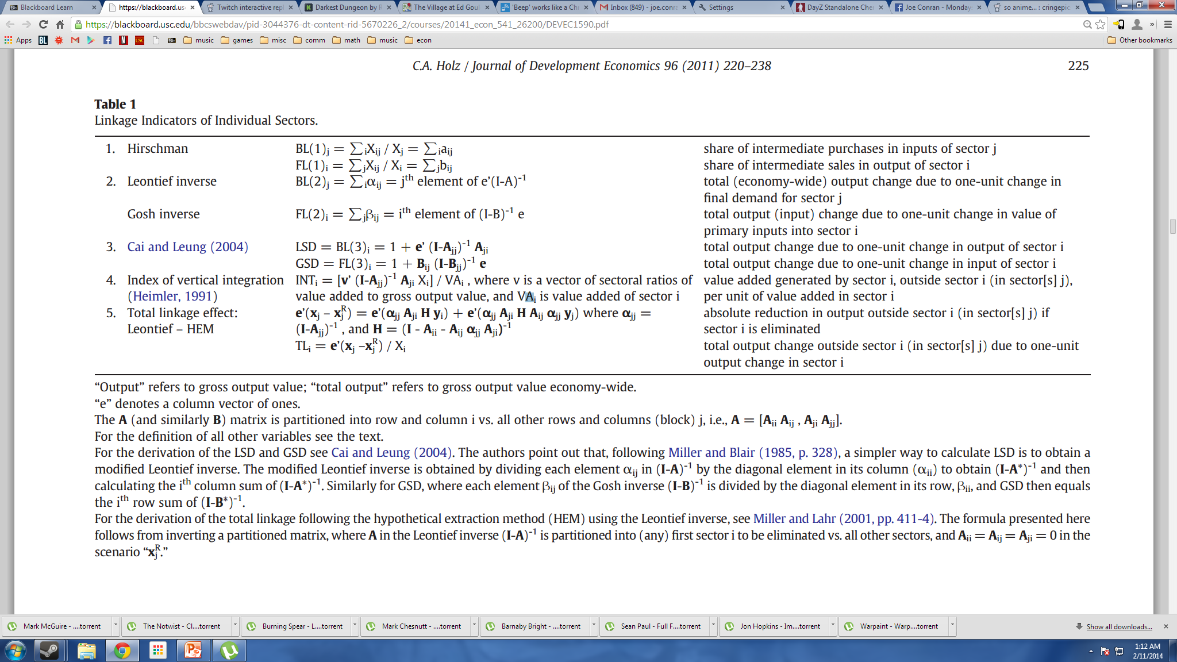
Linkage Indicators

Slide 9
Linkage Values
Considerations
1. Do linkage patterns differ across sectors by region?
If similar, one indicator could suffice for analysis
2. Does each linkage indicator differ across sectors and regions?
If so, unbalanced growth suggests some sectors should receive more attention than other
Critique of some measures: Machinery and Transport Equip ranked low because they go directly to final demand
Profit Linkage How an increase in FD in one sector affects profit over all sectorsMultiplying effect that a particular sector experiences by its ratio of operating surplus to gross output value

Slide 10
Data
National level IO tables exist for most individual years 1981-2005 but not all available. Provincial but rarely available.
Heavy reliance on interregional IO table for 1997 with 8 regions and 17 sectors
Find correlation among the various backward linkage measures and among the forward linkages. Total linkage somewhat more correlated with Backward linkage

Slide 11
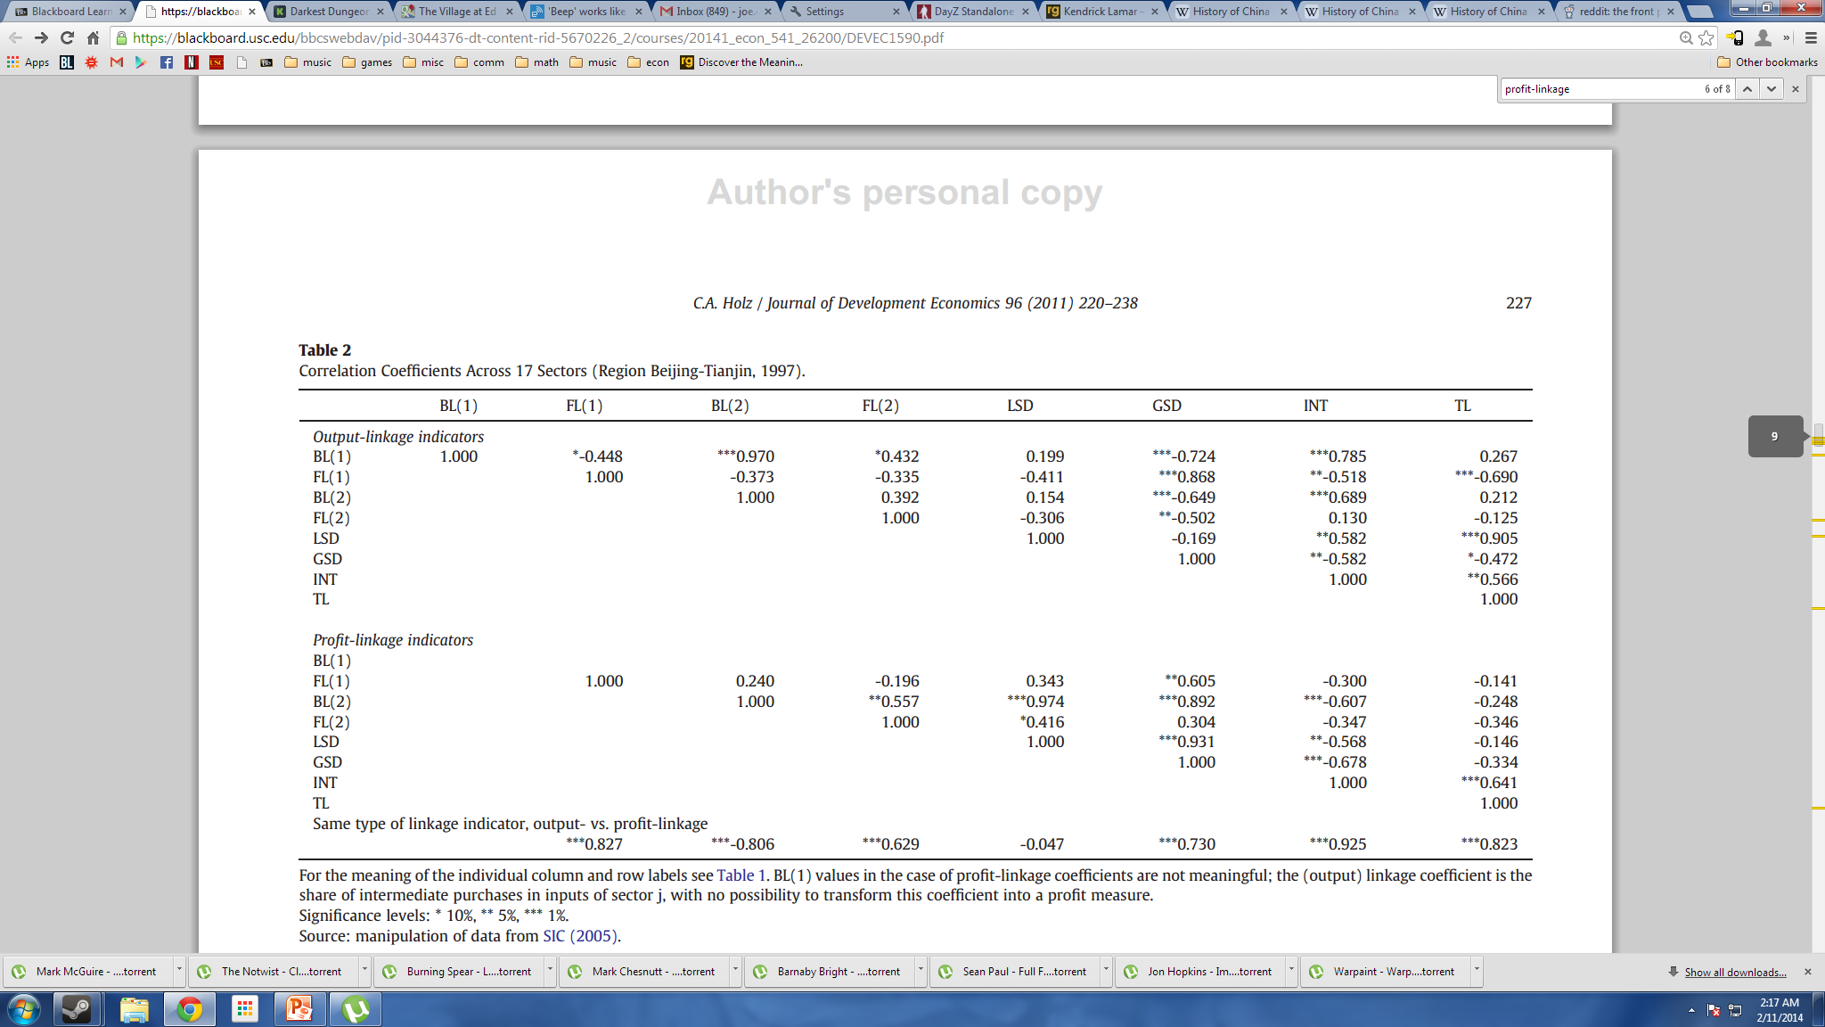
Correlation of Linkage Values
No linkage patterns across indicators. :,(

Slide 12
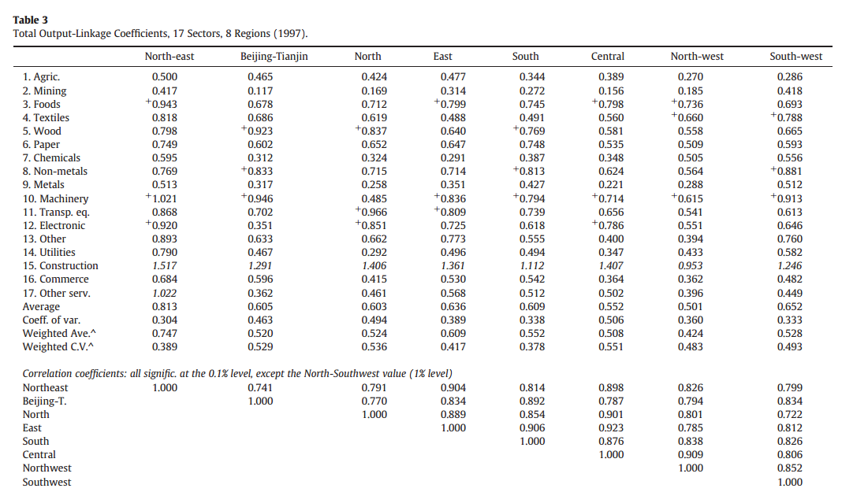
Variation of Total Output-Linkage Across Sectors/Regions
Variation is apparent in output-linkage across sectors and regions

Slide 13
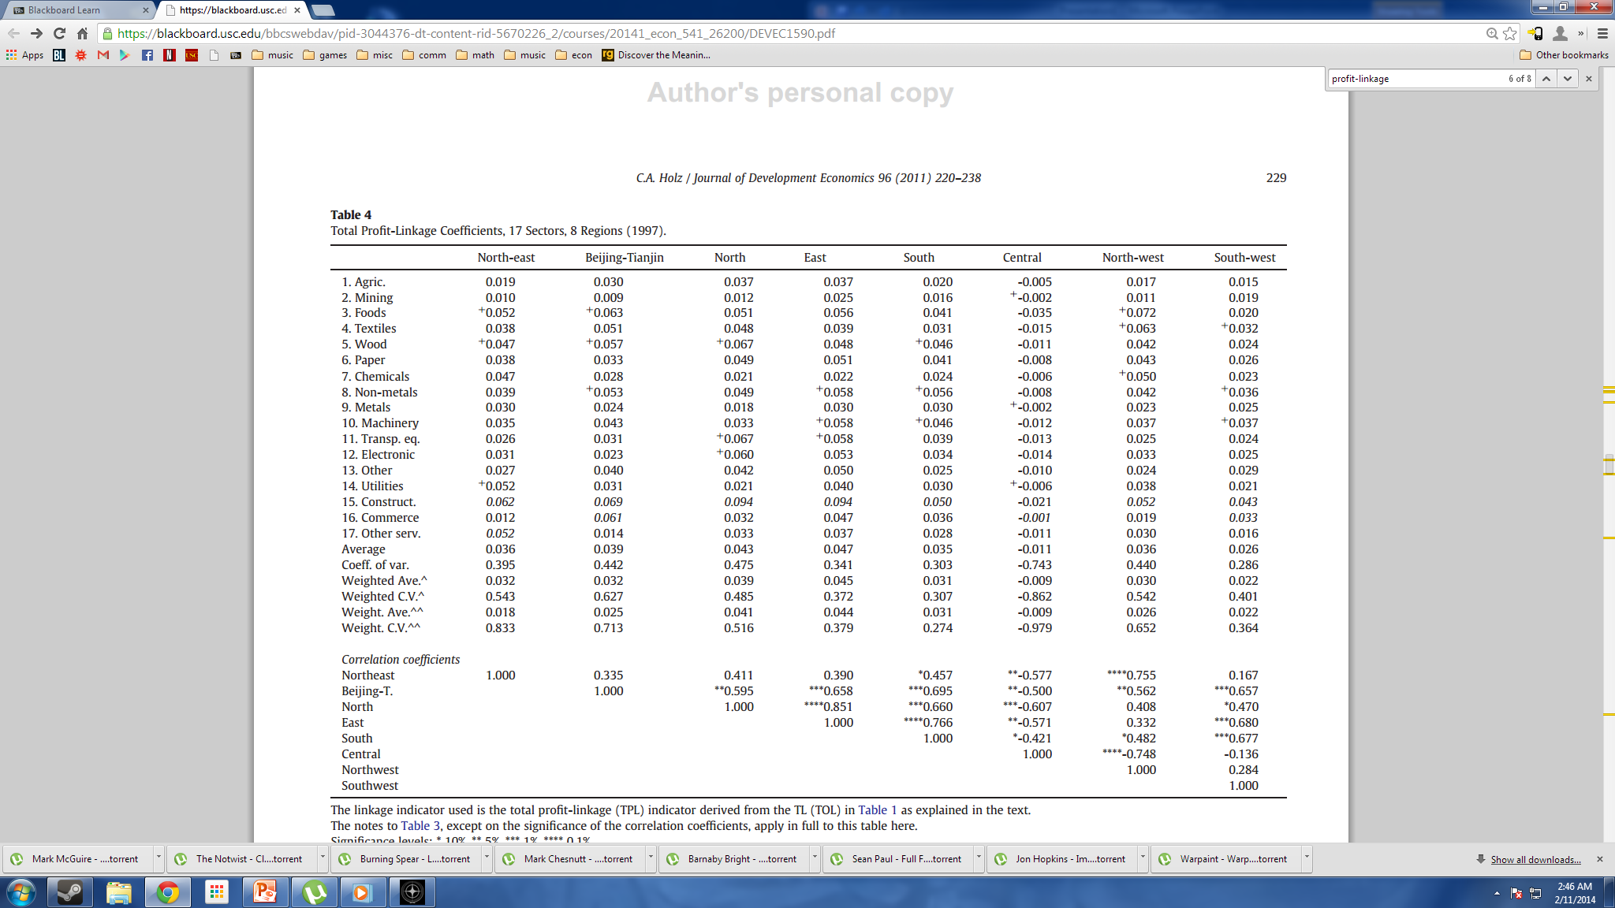
Variation of Total Profit-Linkage Across Sectors/Regions
*
Similar variation in profit-linkage!Average .04 per unit of output change
* Data quality concerns?

Slide 14
Note
In some regions and sectors these are negatively correlated, especially the Central region
More differences between sectors and regions in TPL than TOL

Slide 15
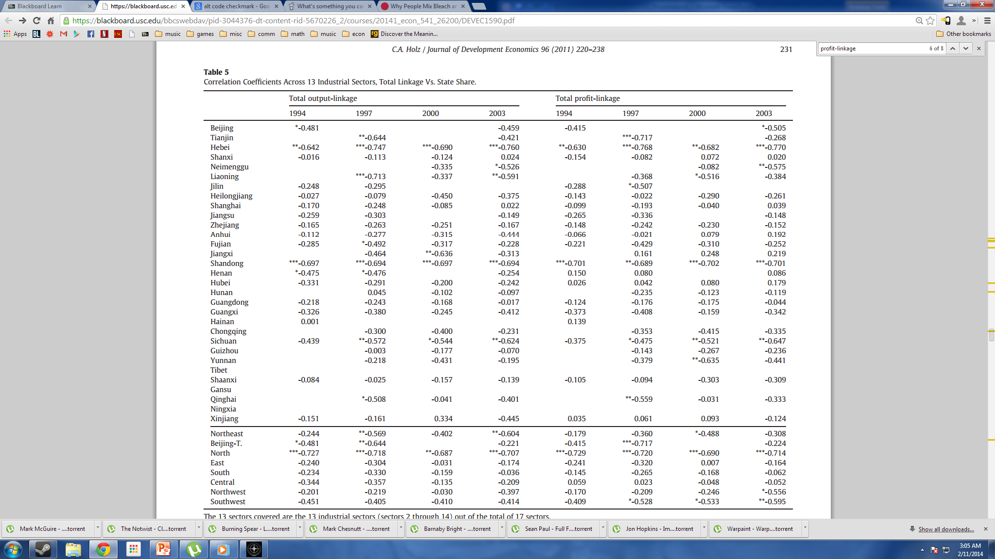
Linkage and State Ownership
Negative correlation suggests state focus on sectors with low linkage coefficients.
Opposes unbalanced growth hypothesis.

Slide 16
Table 5
SOE ownership not correlated with the linkage indexes Table 5.

Slide 17
Table 6. Why Does China Contradict the Unbalanced Growth Hypothesis?
Provincial real GDP growth regressed on provincial industry-wide total linkage coefficients, ownership variable, and interactions of total linkage and ownership variables
Separating into three periods, and adding dummy variables, it is found that TPL and TPL-SOE (not ouptut-linkage) have significant and positive impact on provincial economic growth.
Pure SOE impact on growth is initially negative (1994-97), marked decrease in second period (1997-00 but by third period disappears (2000-03)

Slide 18
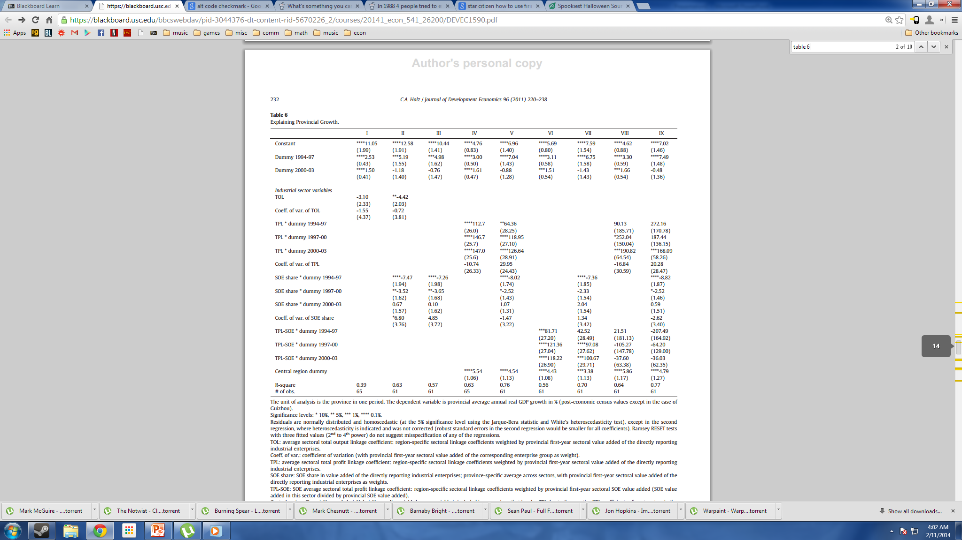

Slide 19
Considerations
Why does China not maintain or improve state ownership in high linkage sectors?
Perhaps not using SOEs
Could measure current-period investment, but for data available, state investment does not focus on high-linkage sectors
Perhaps industrial policy is shaped by politics rather than economics
2001-5 Five Year Plan shows investment in profitable sectors but little focus on high-linkage sectors

Slide 20
Conclusions
Data on China confirms Hirschman’s unbalanced growth hypothesis
The greater the linkage in a Chinese province, the more rapid its economic growth
TPL is a better measure of economic growth than output linkage
SOE share has initial negative impact on economic growth for period 1997-00, but is negated by third period (2000-3)
Chinese state does not promote state owned enterprises in high-linkage sectors
SOE-linkage interaction on economic growth is weak or non-existent

